Slide 1
Fake news detection

Slide 2
What is fake news?
Definition:
Degree:

Slide 3
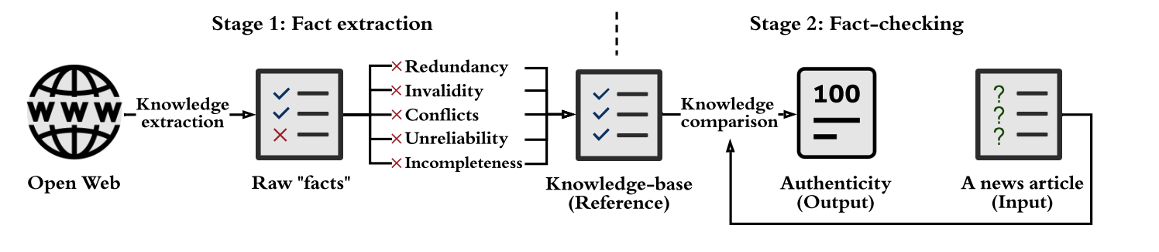
Stage 1: Data mining
Stage 2: Use model check it accuracy

Slide 4
KB: knowledge based
KG: knowledge graph
(Subject, Predicate, Object) (SPO)

Slide 5
Traditional Machine Learning methods

Slide 6
MMFD(multi class-multi source)

Slide 7
LSTM

Slide 8
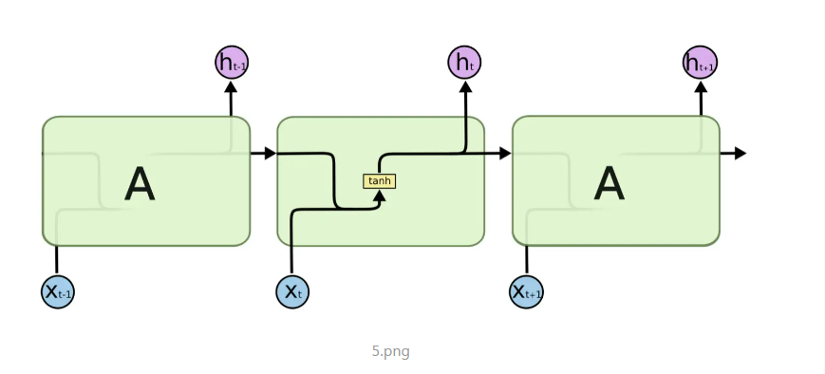
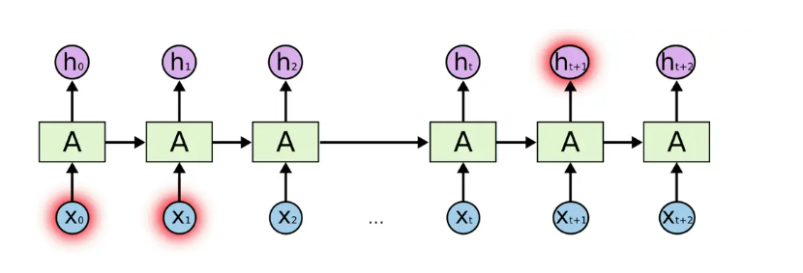

Slide 9
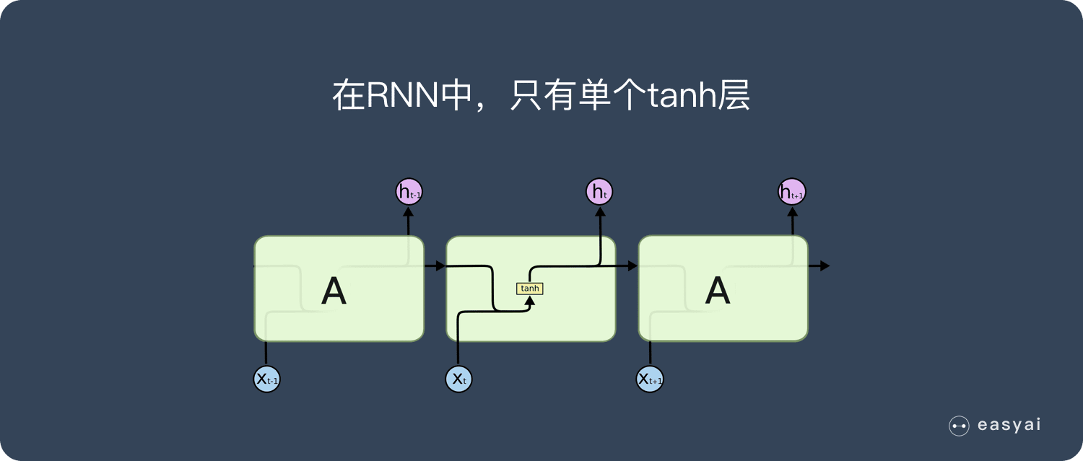

Slide 10
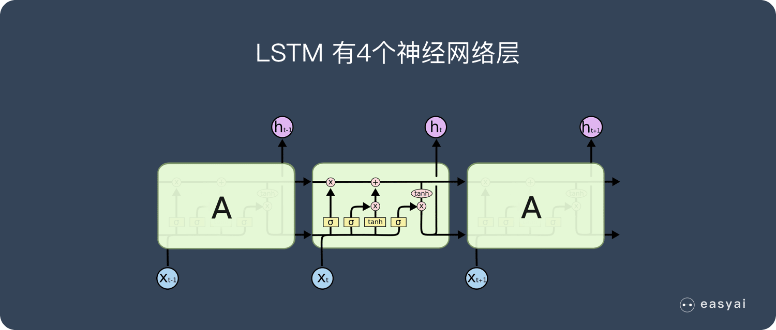
储存门 遗忘门

Slide 11
Dataset(数据集准备)

Slide 12
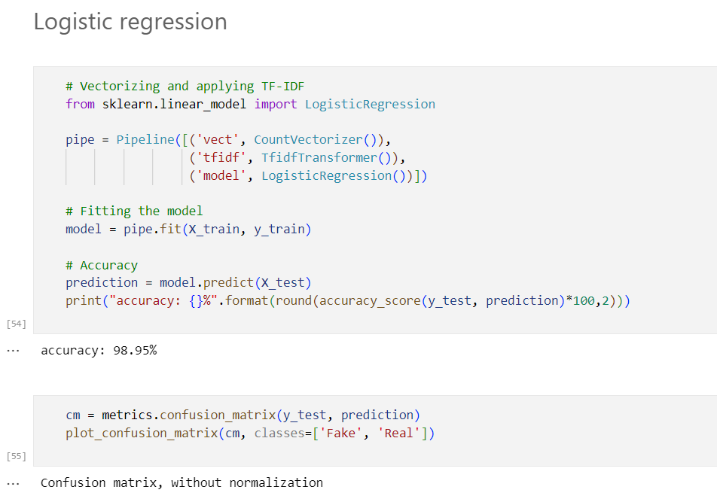
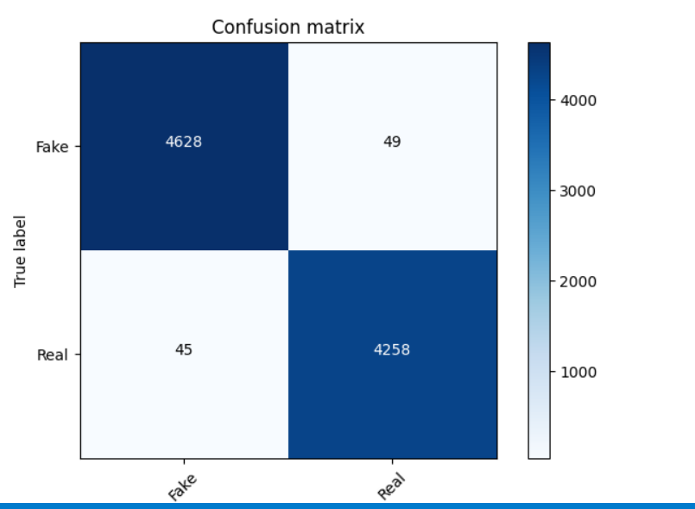

Slide 13
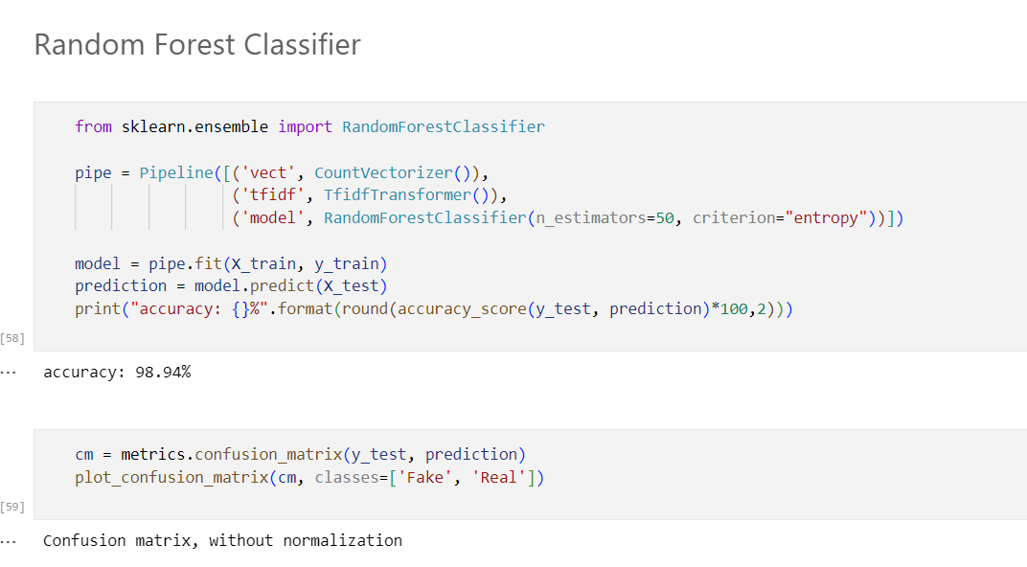
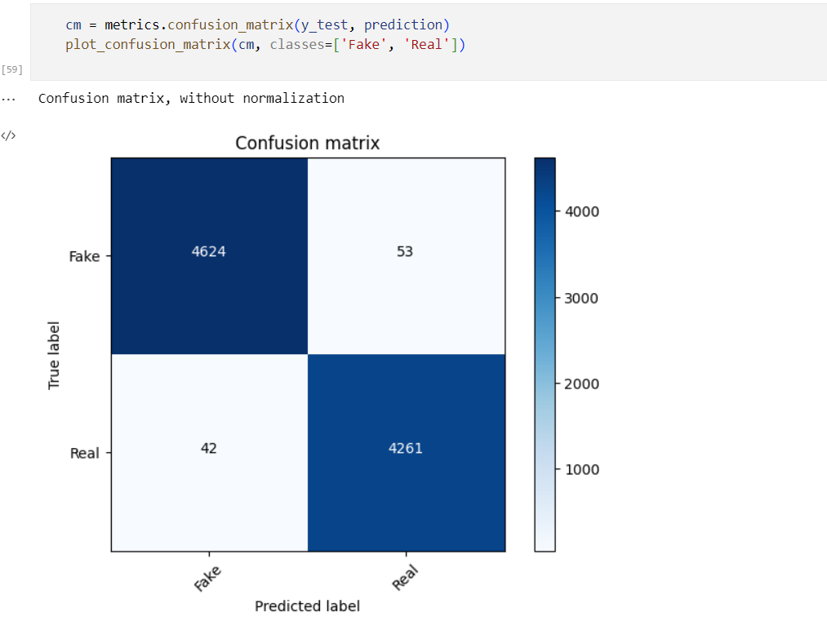

Slide 14
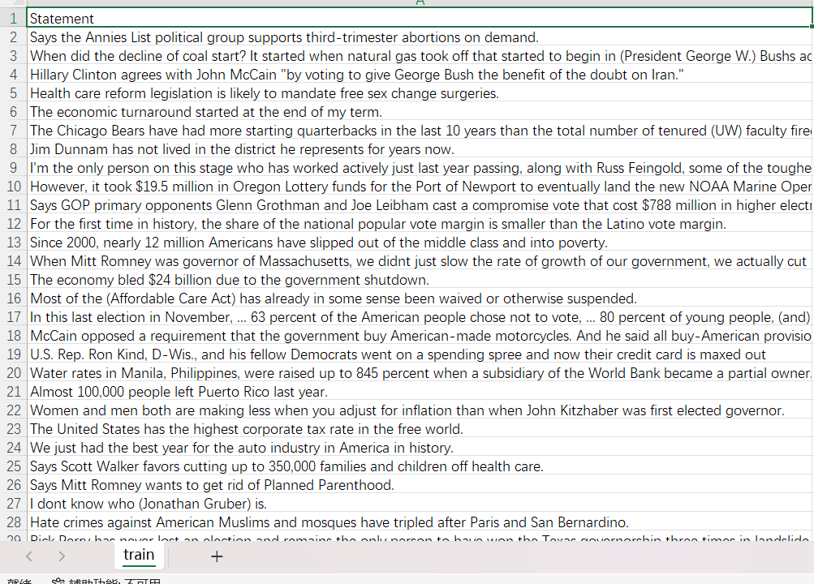
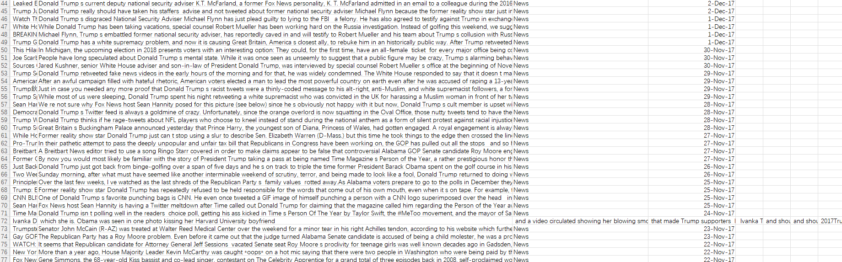

Slide 15
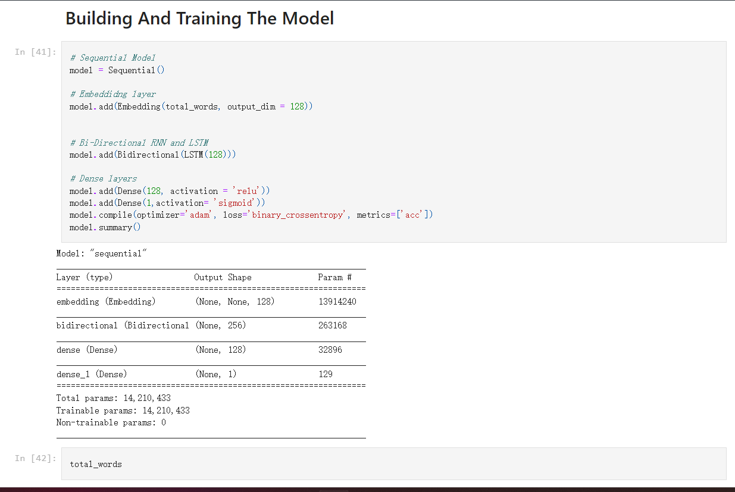

Slide 16
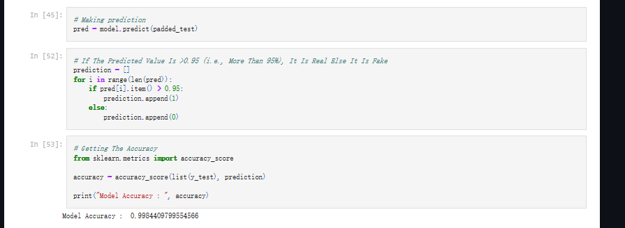

Slide 17
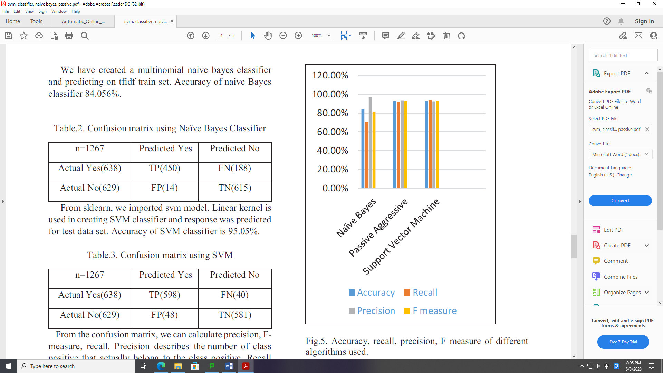

Slide 18


Slide 19
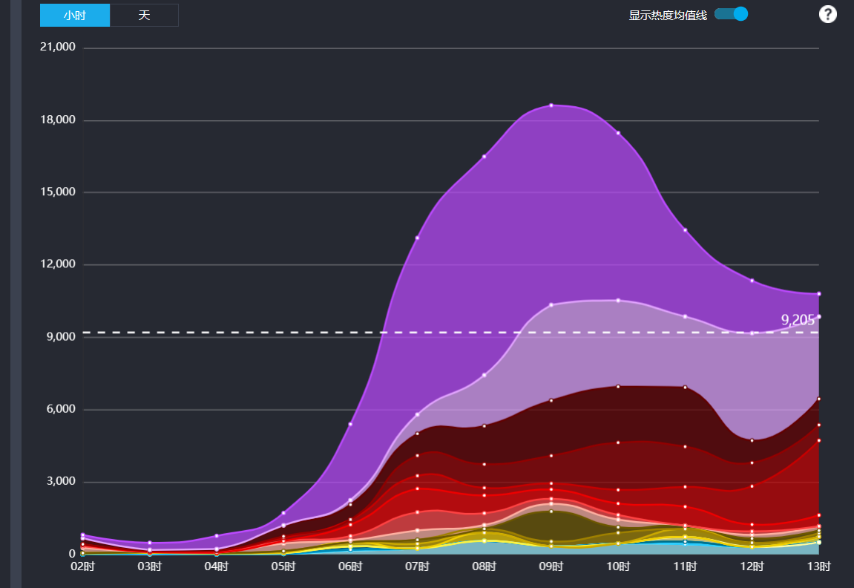

Slide 20
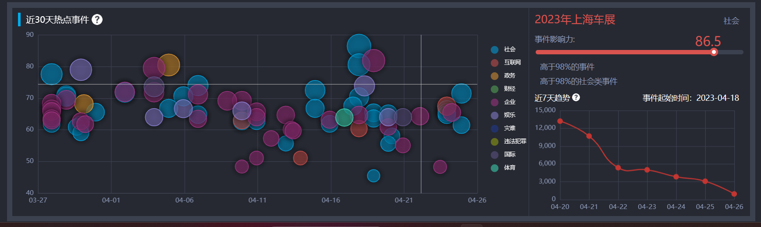

Slide 21
Reference
[1] S. Hochreiter and J. Schmidhuber, “Long Short-Term Memory,” Neural Comput, vol. 9, no. 8, pp. 1735–1780, Nov. 1997.

